Slide 1





Workplace Mediation: resolving conflict at work
Respect | Fairness | Resilience | Resolve

Slide 2
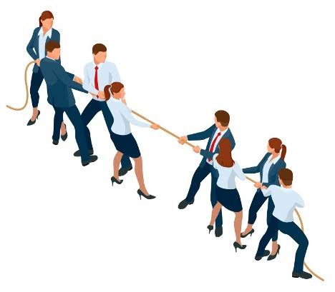
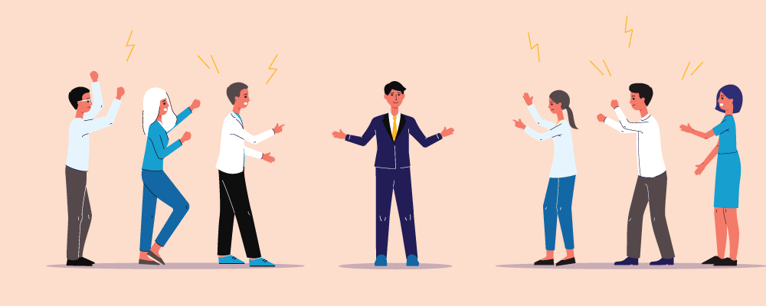
Ditton HR provides workplace mediation services to businesses, universities, charities, councils and other private and public organisations and individuals.

Slide 3

What is Conflict?
‘An actual or perceived disagreement, dispute or difference… usually leading to an increased level of tension between affected parties.’
‘…conflict is a social experience…’

Slide 4

What is Mediation?
‘…it’s a structured and supported series of conversations, between the parties… to lay out, listen to, explore and discuss their experience of the situation that they have been in…to increase each other’s understanding…’

Slide 5
What is Mediation?
‘…it’s a process of information exchange, communicating, listening and educating each other on their respective perceptions, experience, impact, interests and needs… with the aim of resolving the situation…’

Slide 6
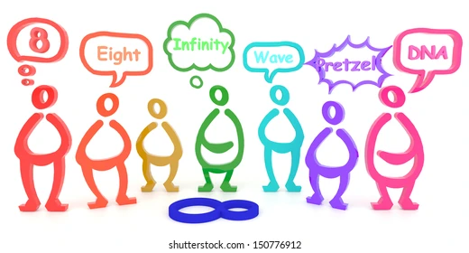
1. What is the ‘Situation’?

Slide 7
Different views of ‘the Situation’
Rarely, if ever, a shared starting understanding of the situation.
- you discover this at the first conversation.
However, there is (usually) a shared understanding of the moment it changed
- i.e. ‘that email’ or ‘that team meeting’, ‘that failed delivery’, ‘that family meal’
Finding this out early is essential work.

Slide 8

2. ‘We’ve not talked about it since’

Slide 9

A common phrase to hear.
‘We’ve not talked about it since’
‘We’ve not sat down to talk about it’
Common stance, ‘time stopped’, until this moment.
Time period may have been weeks, months or years.
‘This is the first time we’ve talked’

Slide 10


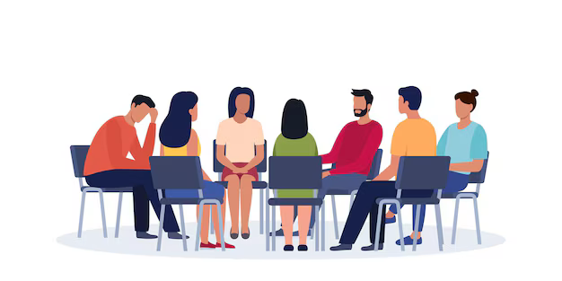
3. The Parties arrive in different moods and frames of mind

Slide 11
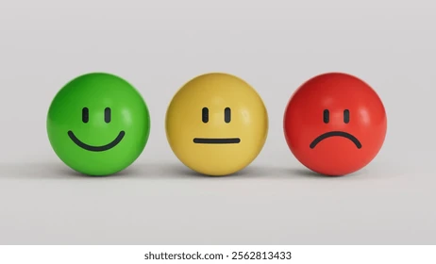
Some parties keen to get on with it. Some parties wish to be somewhere else.
Individual perspectives change between first meeting and joint meeting – parties may have changed thinking and perhaps see things differently.
Hope and Anxiety comes from the road ahead – will we make it, or will we make it worse?
Hope and Anxiety can arise from disbelief, regret and
perhaps and/or embarrassment at own behaviour.

Slide 12
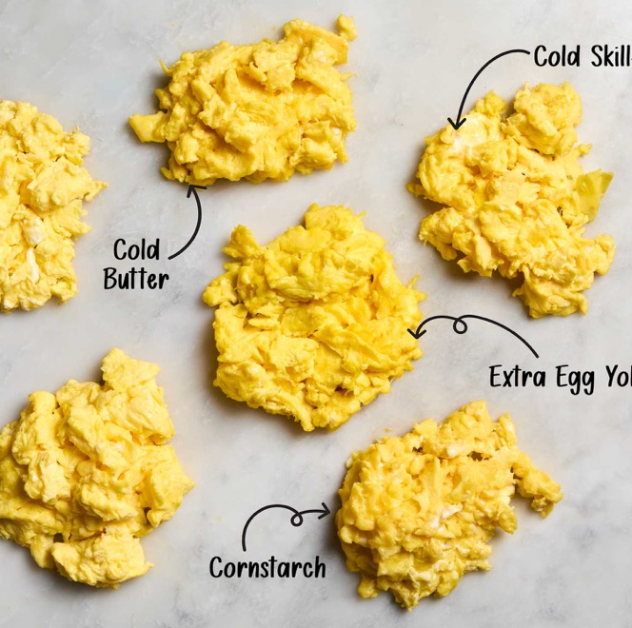
As a mediator, what are we doing? – ‘unscrambling an egg!’

Slide 13
Supporting the coming back together.
- metaphorically and physically, for the first time, after weeks, months or years of conflict and distance.
- with different, clearer, or new eyes on the situation and their own experience of it.
Supporting them to arrive at the mediation process/joint meeting clearer about their own experience.
- and feeling confident enough and safe enough to discuss
it in the joint discussion.
‘An actual or perceived disagreement, dispute or difference… usually leading to an increased level of tension between affected parties.’
‘conflict is an experience… a social experience’

Slide 14
Support the parties to unscramble the egg in their minds.
Built rapport, trust, encourage understanding of themselves… and the other person, in this situation.
Do the individual exploratory meetings well.
Deploy all techniques wisely and skilfully, listening, summarising, reframing, open questions and silence.
‘An actual or perceived disagreement, dispute or difference… usually leading to an increased level of tension between affected parties.’
‘conflict is an experience… a social experience’

Slide 15
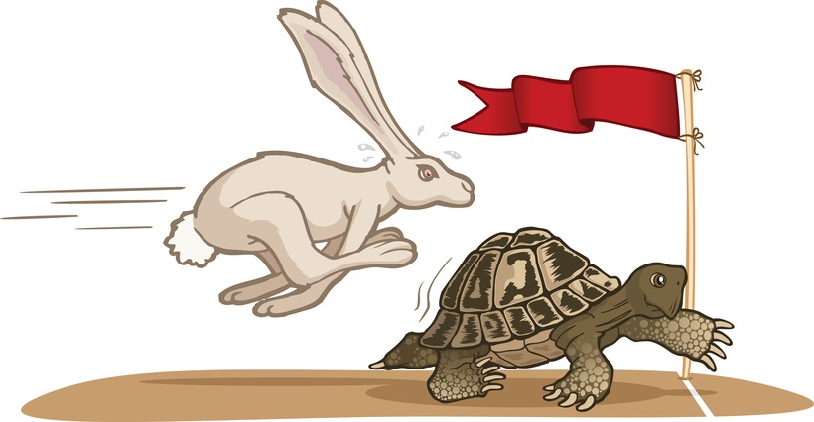
4. Pace, Attention, Flow.
‘Go slow… to go fast’.
Mostly slowing it down – create room for nuance, subtlety, shifts in perception
By listening, summarising, reframing, open questions, silence.
Too fast and things can get missed, e.g. understanding, recognition,
expressions of regret, an apology.
You must remain connected to parties at all times.

Slide 16
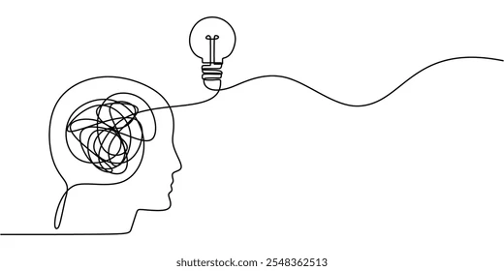
Creating the best atmosphere for parties to think, reflect, speak, shift… to move and create momentum, towards increased understanding and resolution.
It is a second-to-second, moment to moment practice of attention, pace and flow.

Slide 17


5. The non-verbal conversation

Slide 18
Listen to the non-verbal conversation.
- Eye contact or looking down?
- Body posture and position?
- Facial expressions and micro expressions.
Confidence and trust builds through body language first, then words.
Contributes or takes away from the sense of safety in the room.
Encourages, deters or interrupts the movement, attention, pace and flow.

Slide 19




6. The risk with some words!
Some single words don’t help!
Can and will escalate the conversation very quickly.
Impact may be immediate or delayed.
Reframe quickly when you hear them!

Slide 20
Mediation has…
“…the capacity to reorientate the parties…by helping them achieve a new and shared perception of their relationship, a perception that will redirect their attitude and dispositions towards one another…’
(Fuller 1971)

Slide 21
Mediation has…
“…the capacity to reorientate the parties…by helping them achieve a new and shared perception of their relationship, a perception that will redirect their attitude and dispositions towards one another…’
(Fuller 1971)
‘…and there in lies the route out of almost all conflict…’

Slide 22


If your ever need mediation services, please get in touch
Respect | Fairness | Resilience | Resolve

